Slide 1
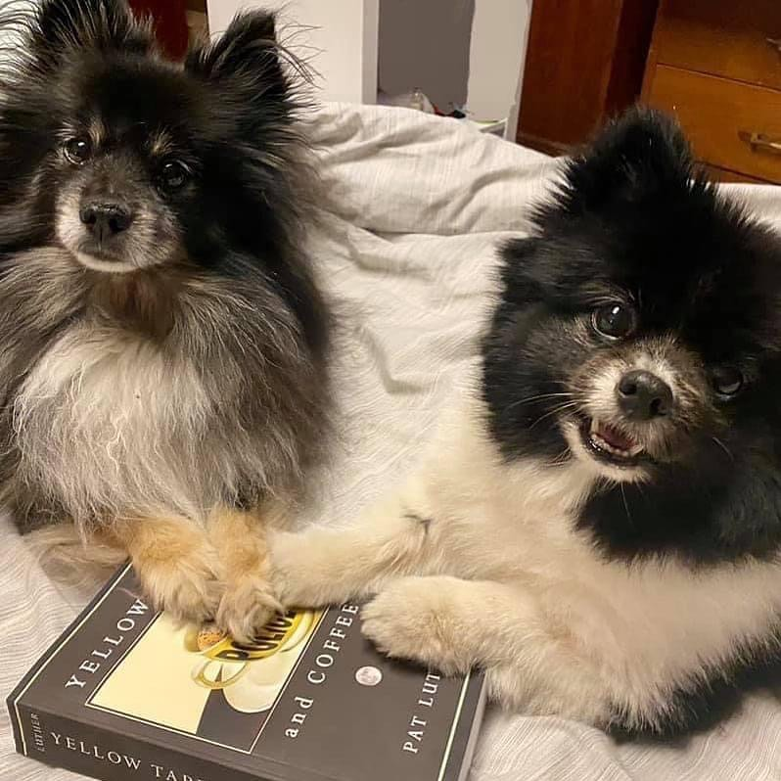
Self-Publishing Checklist
by Pat Luther

Slide 2

Why self-publish?
Control
Speed
Profit
Notes:
More work.
More control.

Slide 3


Roles in Publishing
Role
Author
Publisher
Write Book
Beta Read
Sensitivity Read
Editing
Cover
Formatting
Printing
Audiobook
Distribution
Marketing

Slide 4
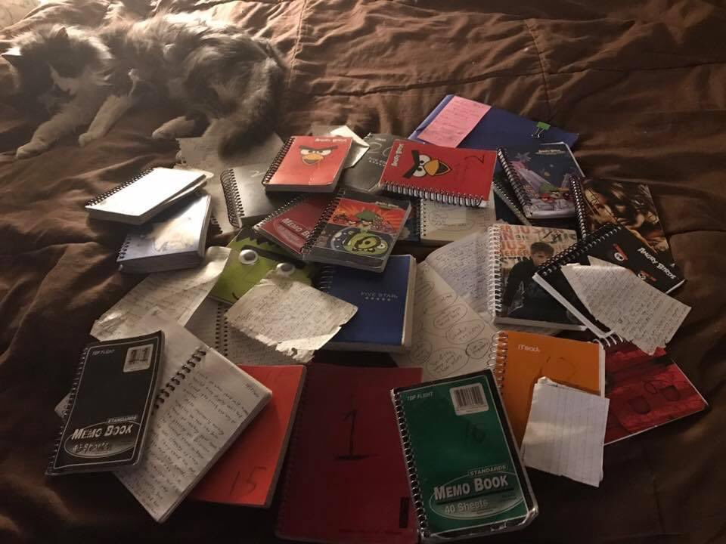
Write the Book!

Slide 5
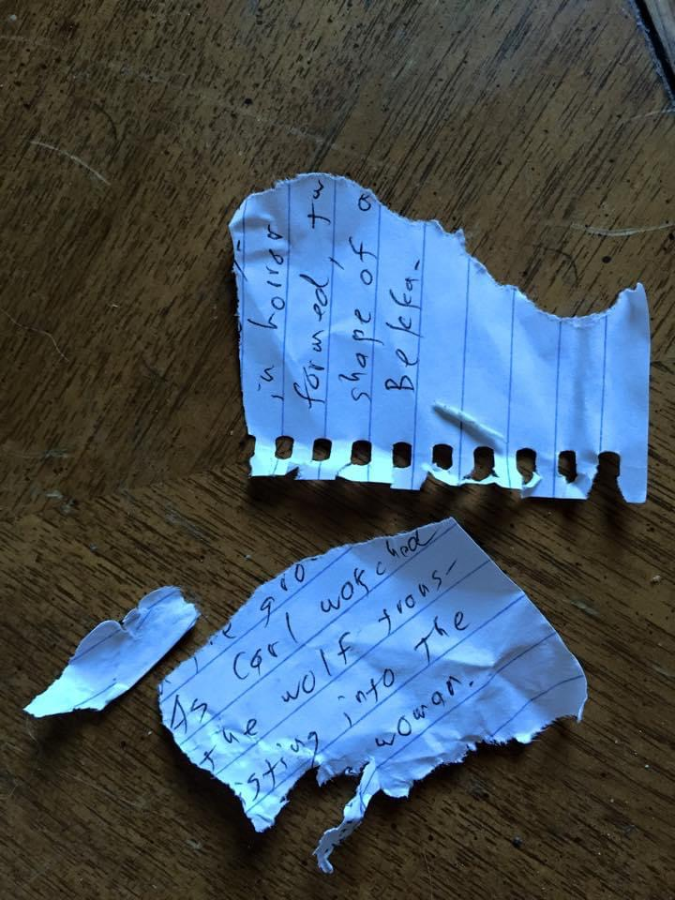
Beta Readers
Expected costs
Go cheap
Fiverr: $20-$500
Professionals: $100-$2,000
Friends
Family
Critique group
Random people from the internet

Slide 6

Sensitivity Readers
Go cheap
Find someone from the culture/group you’re representing and ask nicely.
Expected costs
Offer a trade.
Web sites like writingwithcolor.com
$200-$1,000, usually.

Slide 7
Editing!
Type
How Much?
Go cheap
Alpha Readers
Discussions with Friends
Writing Workshops
Critique Groups
Development
$3,000 - $4,000
Fiverr (be careful!)
Combine Line & Copy
Word, Google, LibreOffice
Text-to-voice and/or read out loud
ProWritingAid, AutoCrit, etc.
Friends
Line
$2,500 - $4,000
Copy
$2,000 - $3,000
Proofreader
Software Tools
Do it yourself!
$1,200 - $2,000

Slide 8
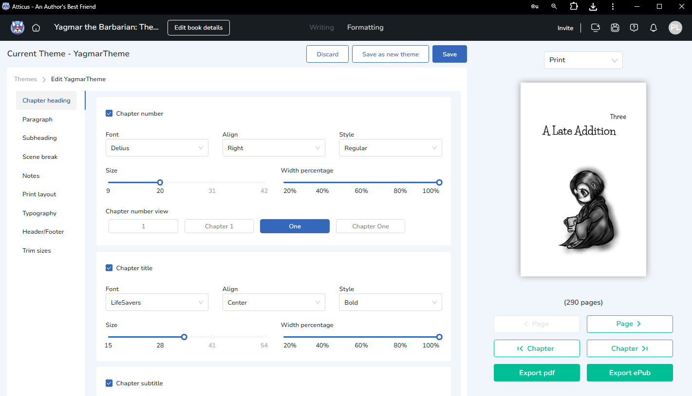
Formatting
Fiverr, Reedsy - $50 - $250
Vellum - $250
(Mac only)
Atticus - $150
InDesign - $23 - $35
per month
LibreOffice - Free

Slide 9
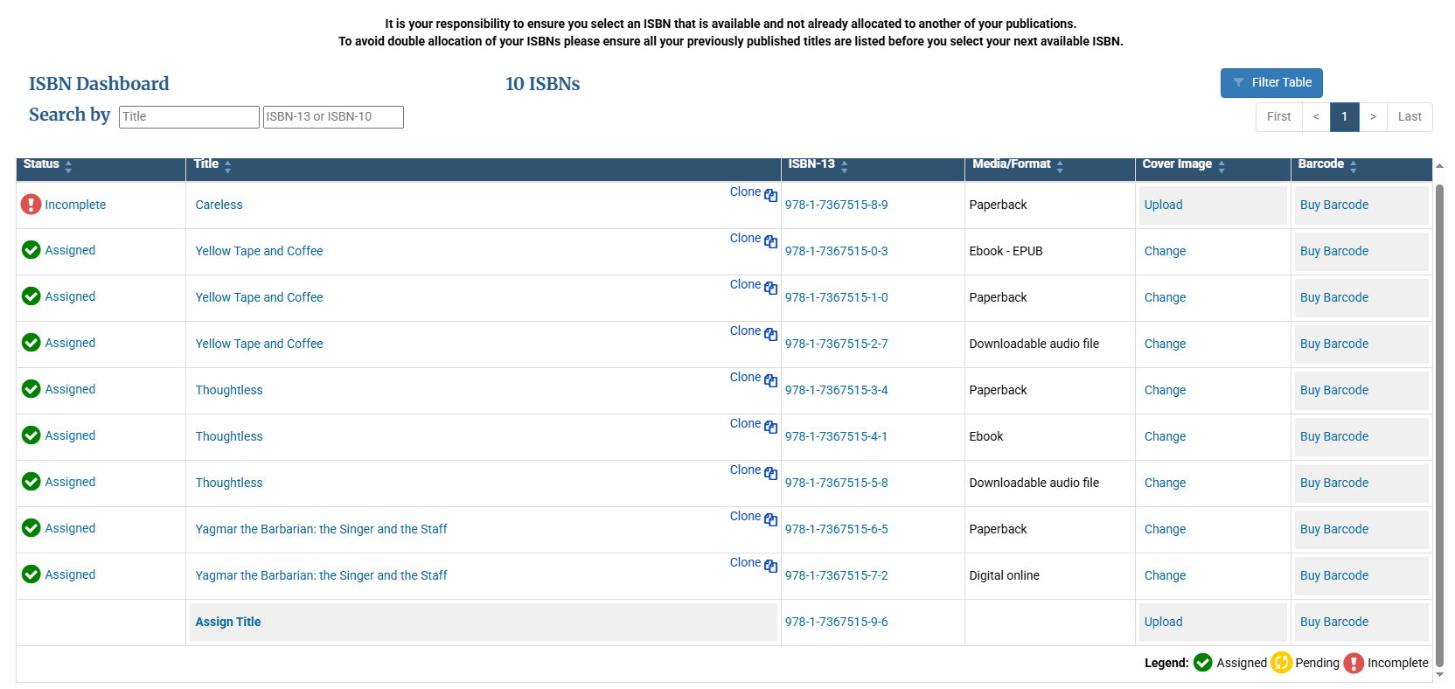
ISBN
Need one for each format (Paperback, Hardcover, ebook, Audio)
Can purchase them now and assign each later. They never expire.
Purchased from Bowker (myidentifiers.com)
$125 for one
$295 for ten
$575 for 100
Free Alternatives
Be Canadian
Ingram Spark and/or Amazon (with caveats)

Slide 10

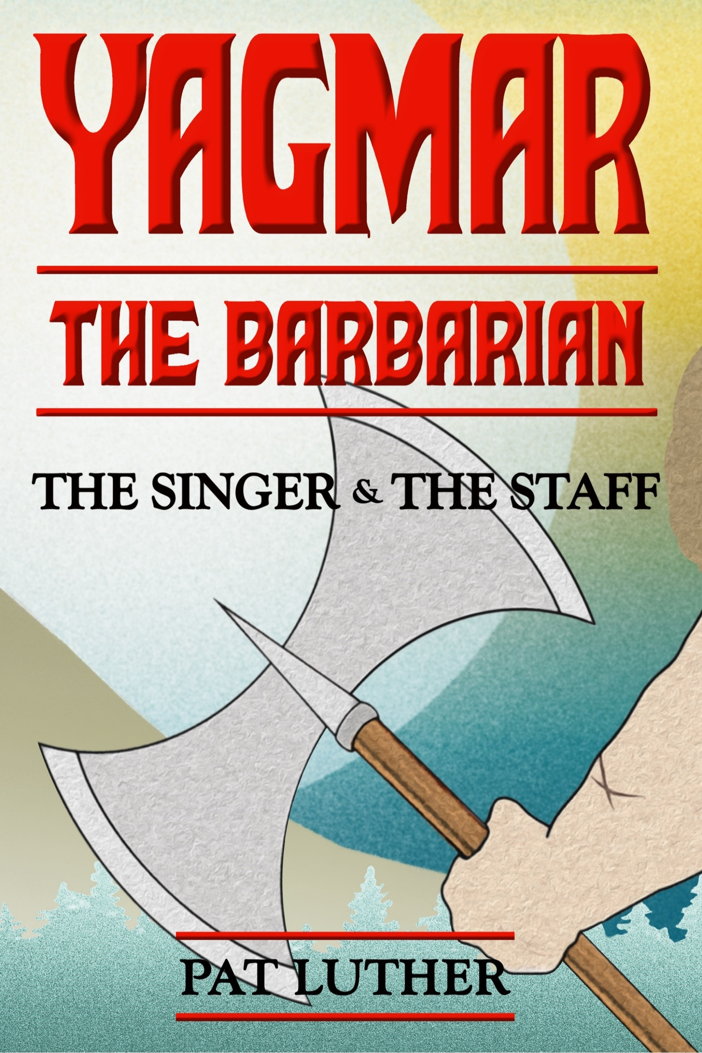

Fiverr
Cover
$300 - $1000 (or more)
Alternatives
Design your own
Canva
Pre-made
cover sites
Free
stock images
Bookbrush

Slide 11
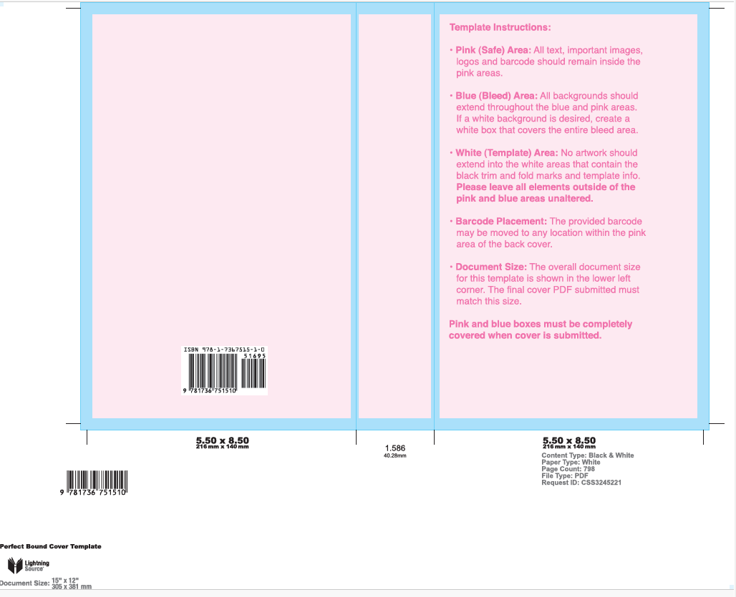
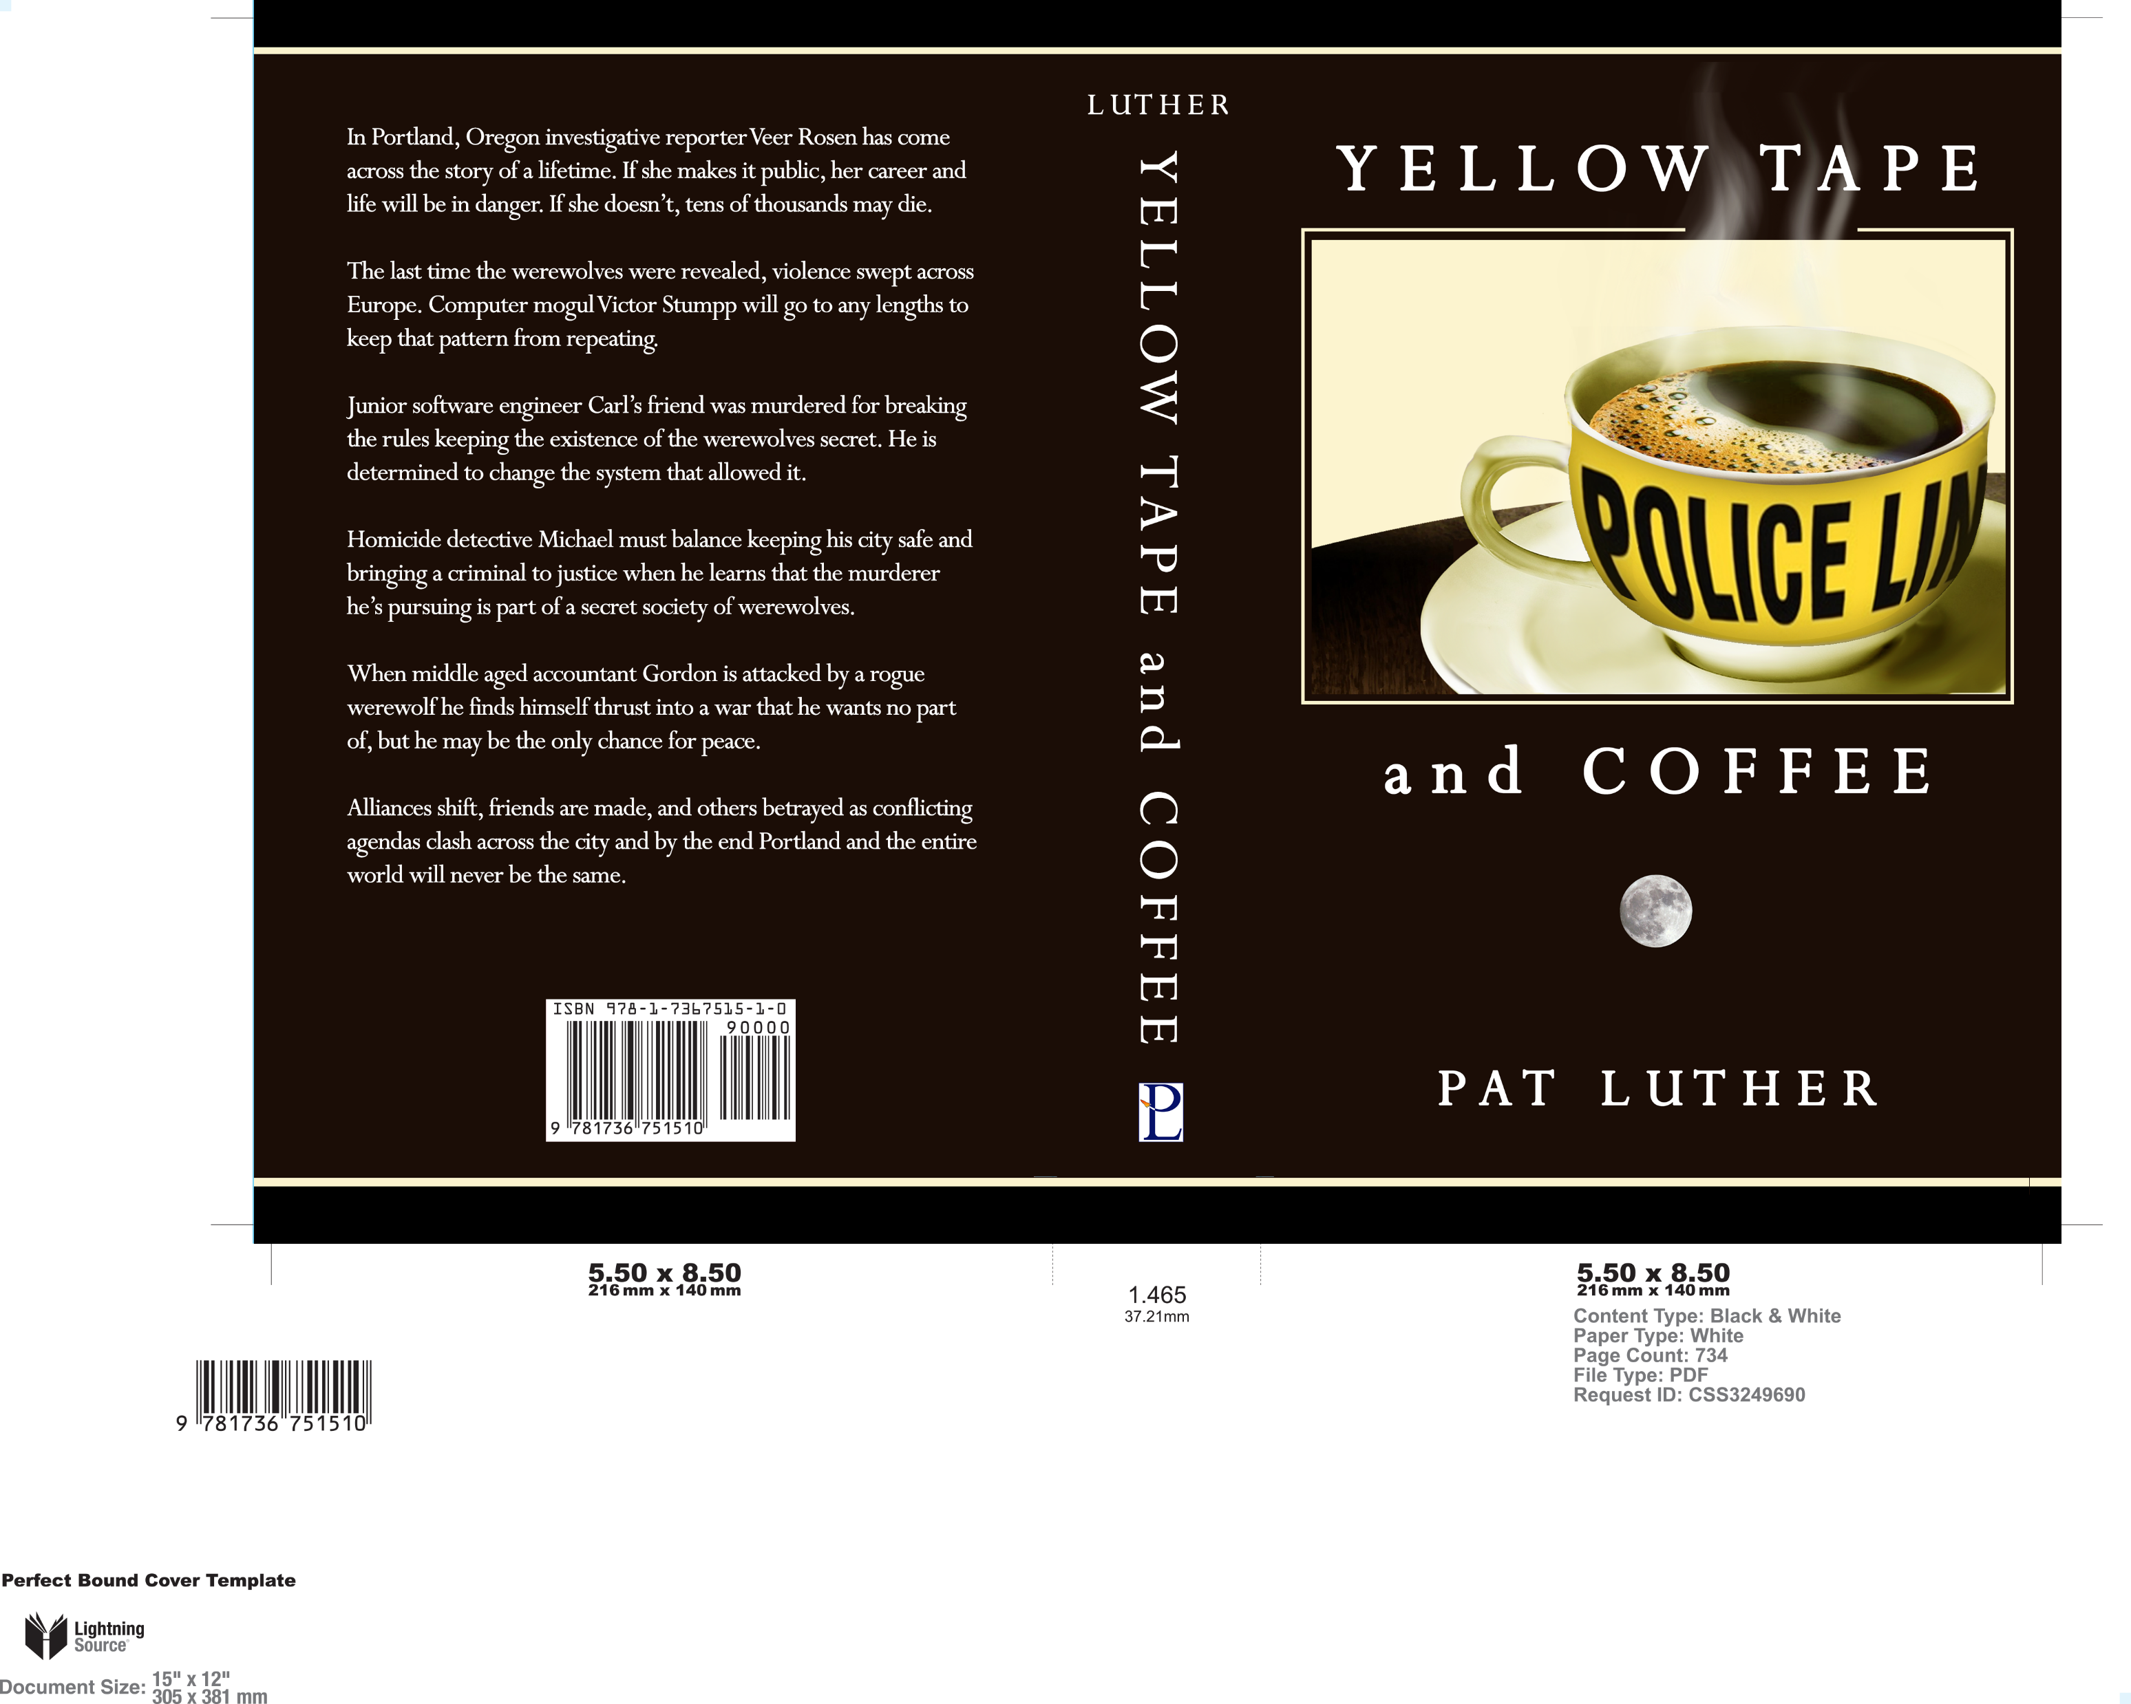
Creating a Cover
ISBN
Price (optional)
Trim Size
Page Count

Slide 12
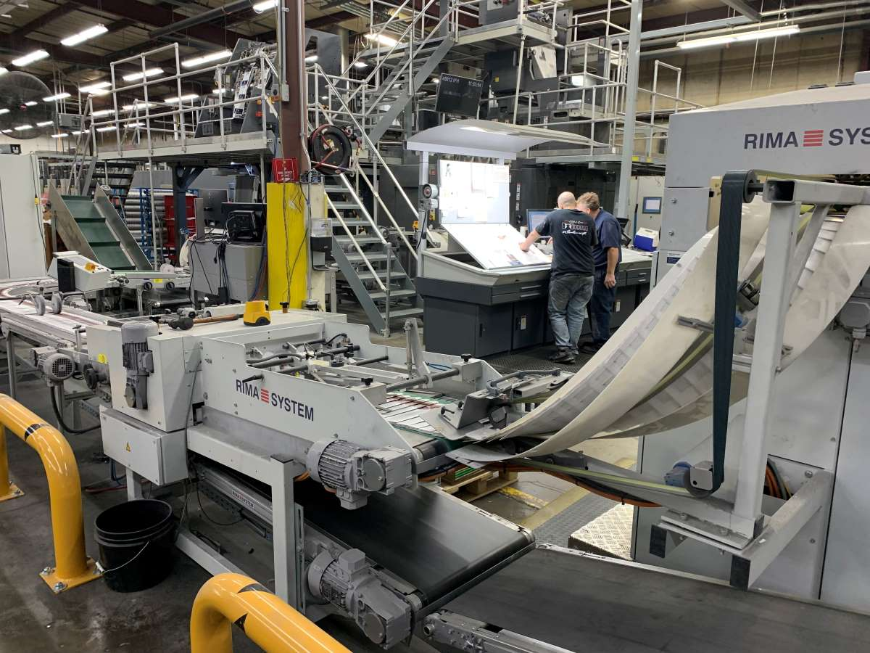
Printing
Ingram Spark (POD/most popular)
Small-batch printers (hundreds to thousands)

Slide 13
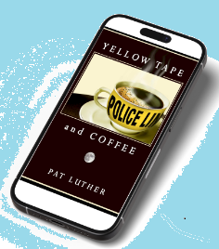
Ebook
To KDP Select or Not to KDP Select?
Select makes ebook exclusive to Amazon
Can enroll in Kindle Unlimited
90-day lock-in
Does not affect availability of print books
Ingram Spark can get ebooks into libraries, Kobo, Apple Books, etc.

Slide 14
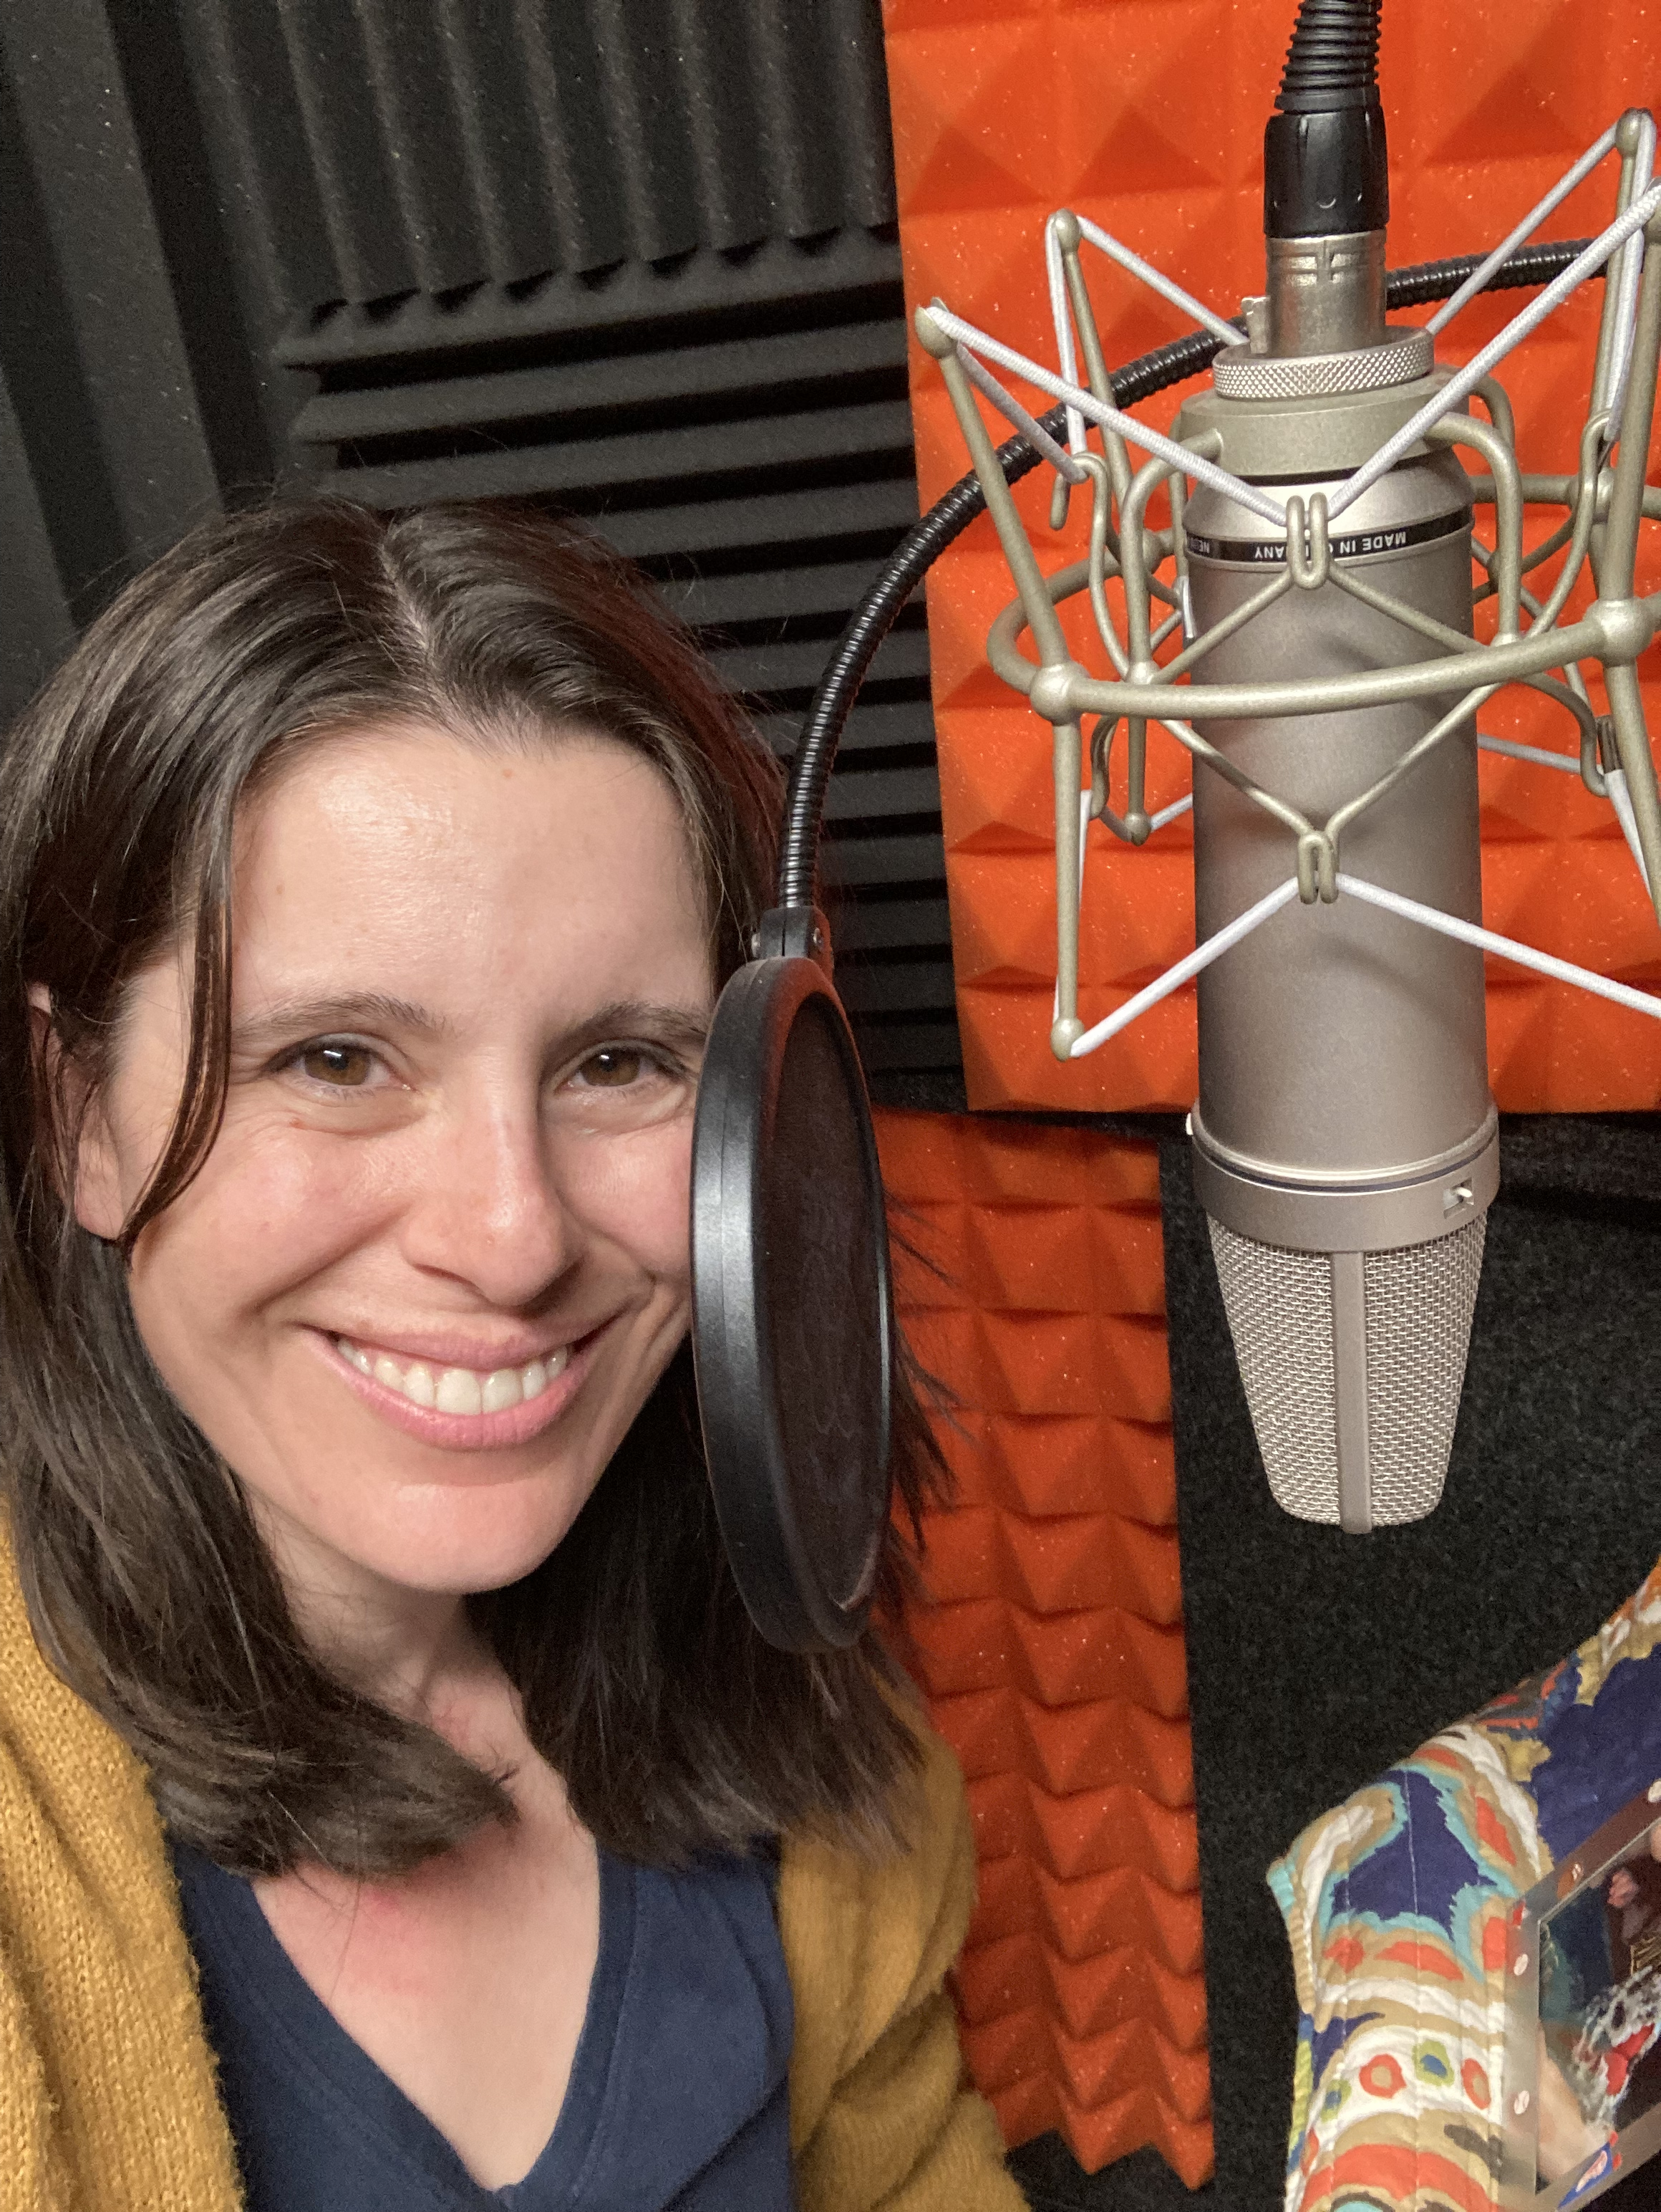
Audiobook
Cost: $2000 - $4000
Alternatives
Royalty Share
Record it Yourself
Distribution
Findaway/Spotify – 80%
Audible – 25% - 40%
Photo: https://www.deborahreevesvoiceover.com/

Slide 15
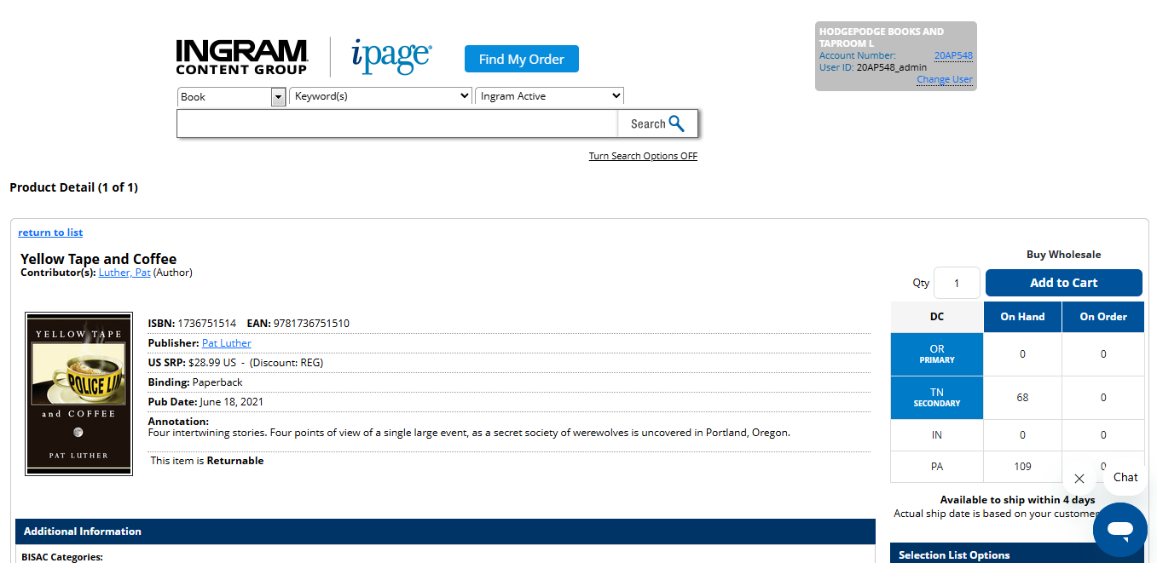
Distribution
Ingram Spark (All libraries & Bookstores world-wide)
Draft2Digital
(Same)
Amazon
(Sort of)
Screenshot: https://www.booksandtaps.com/

Slide 16
Putting it All Together
Before uploading to Ingram Spark and/or Amazon and/or Draft2Digital, you should have:
Short Description & Long description
Formatted interior (.pdf)
Formatted ebook (.epub)
ISBNs assigned to each version
2-4 covers:
  Paperback (using template(s))
    Spine art & blurb on back
  Ebook (with front cover image only)
  Audiobook (1200x1200 pixel square version of front)
Checking Account Information (so you can get paid)

Slide 17
Metadata!
  Important bits:
  Pricing – may have to go back and forth between Bowker and Ingram-Spark
  Keywords – Make them up, look up other books, or use a tool like Publisher Rocket to find them
  Published Date – Stores can do pre-orders immediately, but I-S won’t ship until this date
    Make it far enough in the future to have time for proofs, changes, and pre-sale marketing
  On-sale date – I-S will begin taking pre-orders on this date. Leave it blank if you want it available immediately

Slide 18
Miscellaneous
Proofs! Digital & Physical
ARC copies: email or use BookFunnel
Getting the word out
  Social Media
    #bookstagram, #booksky, #booktok
  Paid ads – Facebook, Amazon, Google
  Interviews, podcasts, blogs
  In-person events
    With other author or groups (NIWA!)
  Panels & Presentations
  Contests (90-second pitch contest

Slide 19
Questions?
  Follow Pat online:
  https://pluther.us
  https://www.facebook.com/PatLuthertheWriter
  https://www.instagram.com/plutherus/
  https://bsky.app/profile/plutherus.bsky.social
  YouTube: plutherus
  Newsletter! (Sign up on website or here)

