Slide 1
Pat Luther
Werewolves to Asteroid Miners: Mining Mythology

Slide 2
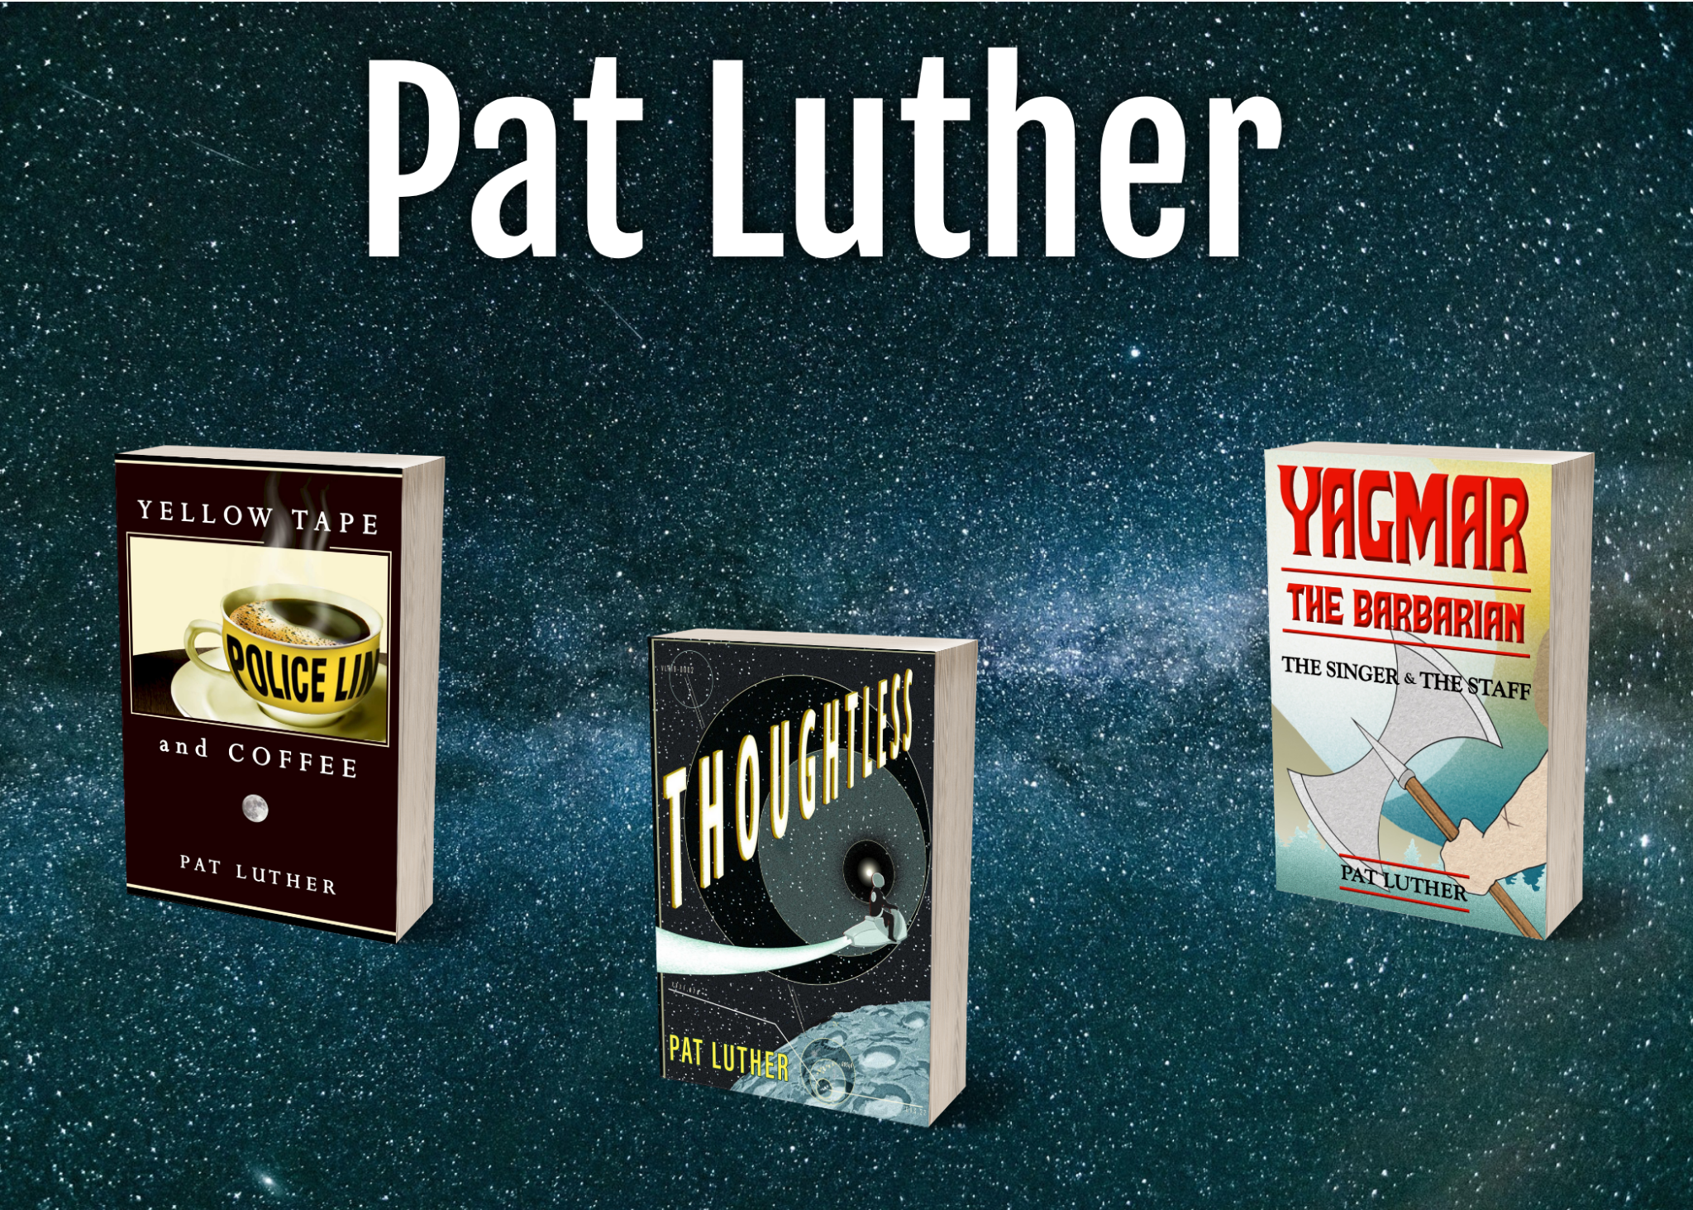

Slide 3
Myths?
Mythology: Sacred Stories
Mythbusting: Widely believed things that aren’t true

Slide 4

Myths?
Mythology: Sacred Stories
Mythbusting: Widely believed things that aren’t true

Slide 5
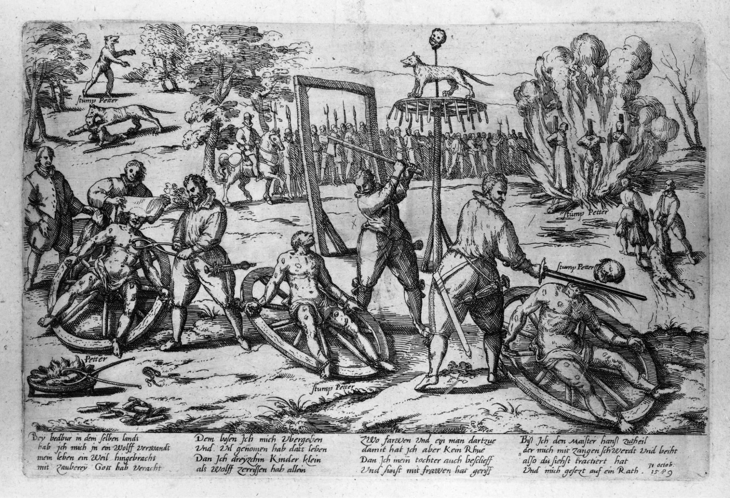
Mythology
Werewolves
    Nebuchadnezzar
    Lycaon
    Navajo Skinwalkers
    Romulus and Remus
    Rakshasa
    Peter Stumpp
    The Wolfman (1941)

Slide 6
Werewolves - Classic vs Modern Lore
When they change:
  At will
  Under full moon
  Under stress
  When specific ritual is performed
How to become a werewolf:
  Cursed by god
  Family curse
  Wear the skin of a wolf
  Drink from a wolf print puddle under the light of a full moon
  Chosen by previous village werewolf
  Dance naked under the full moon
  Raised by wolves (Romulus & Remus)

Slide 7
How does it fit in?
Discussions among characters
  Lore not used/rumors
“The rules”
  Invulnerability vs Regeneration
  Silver
  Full moon
  Transmission through bites
  How transformation is triggered
  Clothes

Slide 8
Traits (Combine both meanings of myth!)
Werewolf
“Alpha”
Constant fighting for position
Lone hunter
Ravenous killing machines

Slide 9
Traits (Combine both meanings of myth!)
Werewolf
“Alpha”
Constant fighting for position
Lone hunter
Ravenous killing machines
Wolf
Family units
Frequently form new packs
Pack hunters
Kill to eat

Slide 10
Traits (Combine both meanings of myth!)
Werewolf
“Alpha”
Constant fighting for position
Lone hunter
Ravenous killing machines
Wolf
Family units
Frequently form new packs
Pack hunters
Kill to eat
Human!
Hierarchical groups w/ dictator
Politics/Power seeking
Hunting is often an individual activity, even in groups
Kill for fun/sport

Slide 11
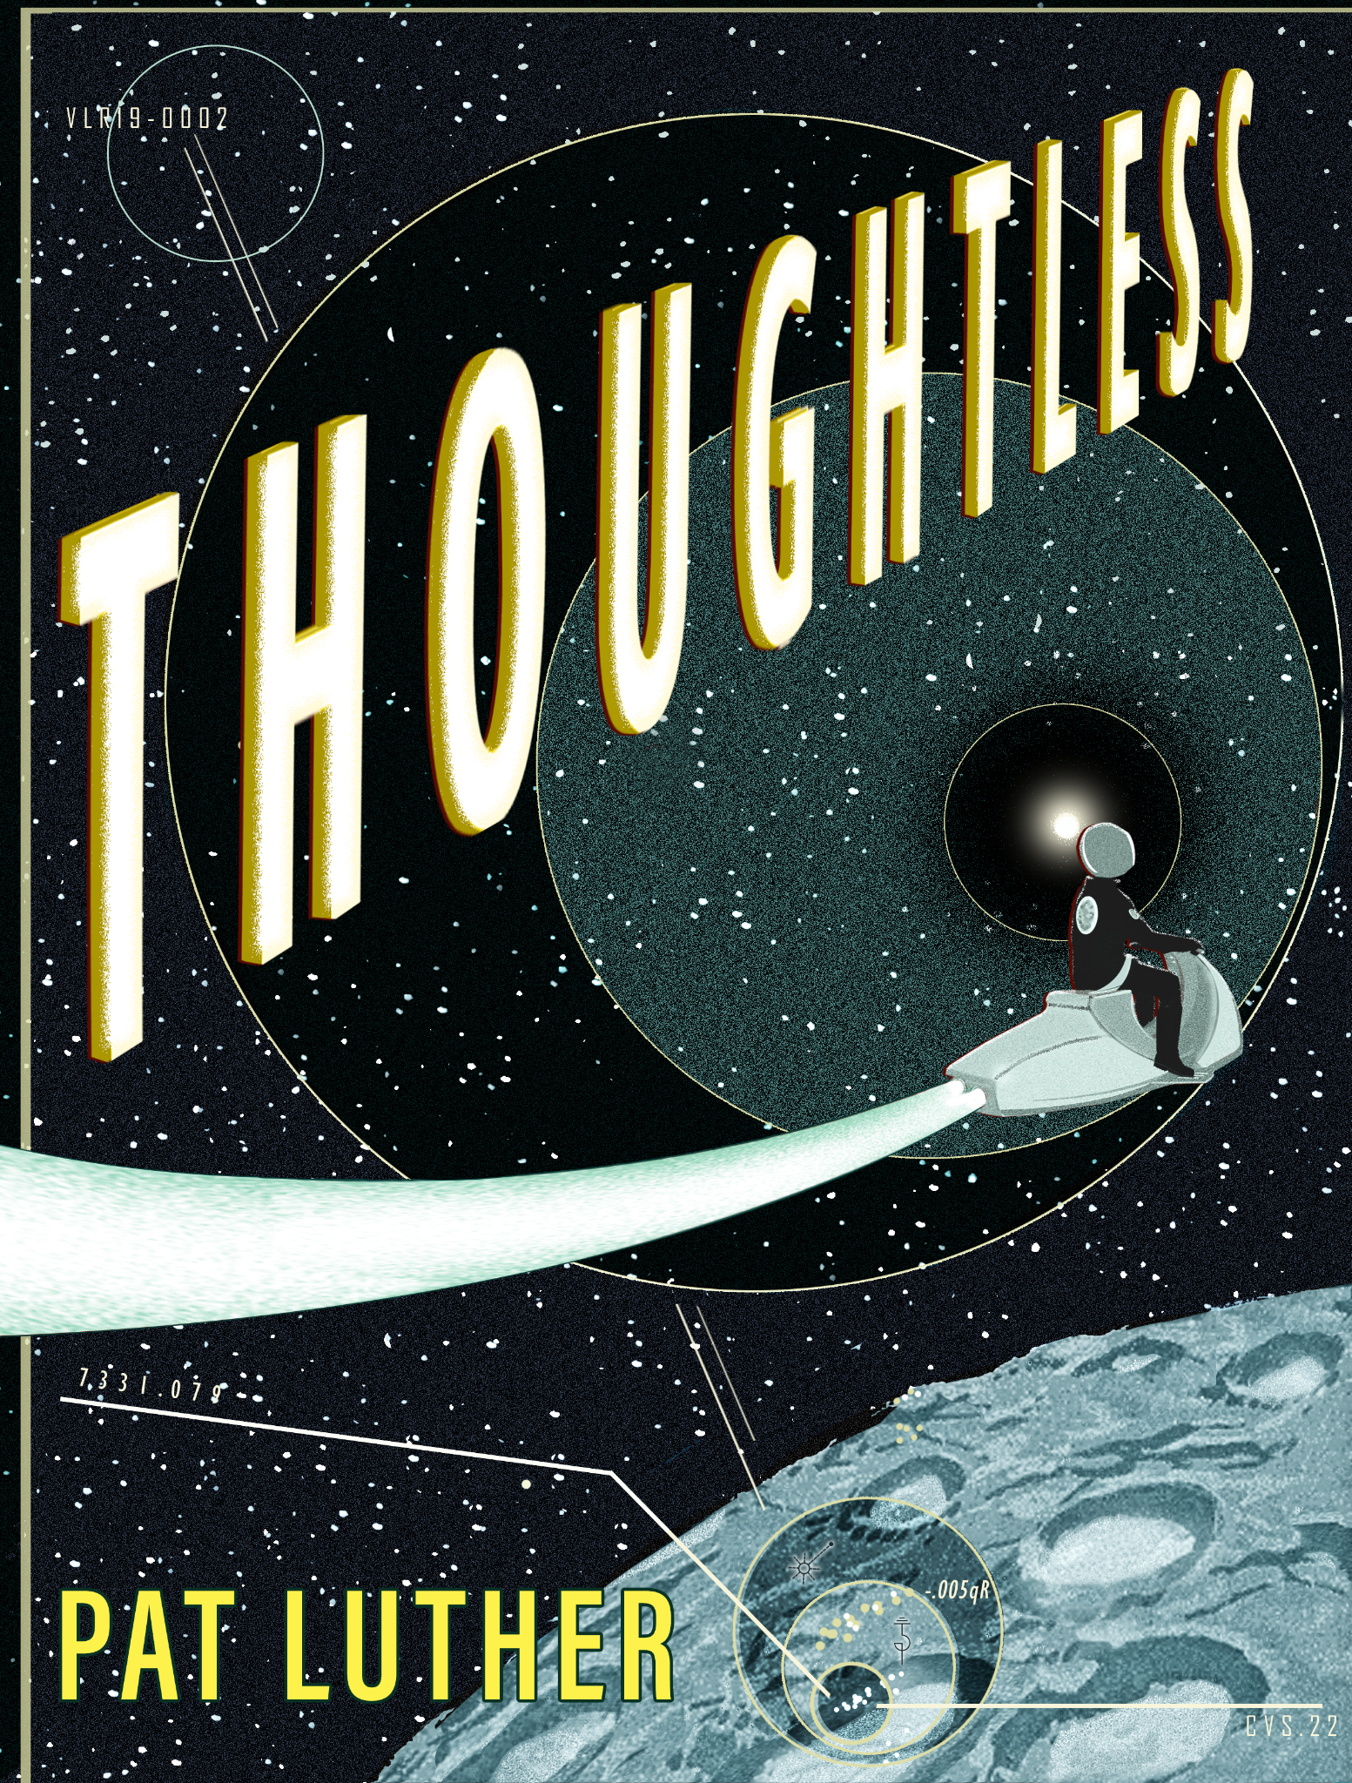
Mythology: What about in a Science Fiction setting?

Slide 12
People have always had sacred stories
People have always had sacred stories - they likely still will.
Legends change over time, and pick up traits from others (see all of Roman mythology, for example)
Dune had Zensunni and Orange Catholics
Thoughtless religions:
  Ares
  Martian Polytheism (“Luck”, “Protection”, “Knowledge” → “Shanso”, “Egido”, and “Scio”
  Belt-native religion (Belt-born “angels”)
  Earthseed easter egg “God is change”
Hopi - Falling stars/meteors/souls returning
Hathor - made path to heavens
Wakah chan - “White road” (mirrored in sacbes)
Yggdrasil - World Tree - roots below, branches above

Slide 13
Mythbusting (for fun and profit)
Werewolves
  See YouTube & online discussion forums
Police
  If you ask an undercover cop they have to tell you
  Warning shots, “Shoot them in the leg”
  Most dangerous job
  High suicide rate
Space
  Asteroid belt isn’t like Star Wars

Slide 14
Other sources - kind of mythology
Conspiracy Theories!
JFK assassination
Lincoln assassination
Fake moon landing
Hollow Earth
MKULTRA
COINTELPRO
Operation Paperclip

Slide 15
Other sources - not, technically, “mythology”
Historic people/events
  Nellie Bly
  French resistance
  Ronald Reagan
  Julie d'Aubigny
Outlaw Folk Heroes
  Pretty Boy Floyd
  Bonnie and Clyde
  Claude Duval “The Gallant Highwayman”
  Butch Cassidy and the Sundance Kid (thanks to Paul Newman and Robert Redford)

Slide 16
Even more sources: Other people’s stories
Friends
Family
Acquaintances
People you’ve met once and had a random conversation with
  Grant
  Police:
    Friend hoping to be a detective in Portland
    Stockton PD
    The cop who found my mom
    Police who’ve done public talks

Slide 17


